Slide 1
Computer Principles for Programmers
Course Overview, Basics of File Systems and Visual Studio intro
Notes:
Welcome. Bienvenue. There are many other languages our colleagues speak; please say "welcome" in another language.
Embracing diversity is being willing to understand an issue from many points of view (the Apple formula for success). You encountered greetings you didn't understand –words are code for concepts. Given the context, you knew they meant something friendly. Greetings in some cultures can mean much more than a simple hello, e.g. "Shalom or Namaste or Salam". To really appreciate the person we refer to as the end user, we must also understand what they mean culturally, not just what they say in words.
Gender diversity is an issue in the IT industry. We need more women in this business for another point of view – a special welcome to the women in our class who are willing to put up all the guys. Since 2011, the percentage of women in ICT has ranged from 29.5% to a low of 26.4% with 26.7% in 2018. the ICT industry is facing a talent shortage. Canada will need to fill more than 200,000 technology-related positions by 2021. The growth in these jobs has outpaced the overall economy in the last two years by 4 to 1. Our supply of ICT graduates and workers will not meet this demand. (https://www.thestar.com/opinion/contributors/2018/07/01/its-time-to-close-the-gender-gap-in-tech.html)
Diversity is strength in IT – especially in software design and in the creation of the UX – User eXperience. Different points of view from various languages, cultures, genders, industries, disciplines are all valuable in designing and building good software. Facebook, Amazon, Apple, Netflix, Google (FAANG) would not be as successful, without multiple POV. Apple used to hire liberal arts majors. Steve Jobs: "technology alone is not enough—it’s technology married with liberal arts, married with the humanities, that yields us the results".
Students are not only here to learn from professors and course materials, students are also here to learn from each other – something you cannot do on YouTube. People come to college to improve their social skills for the business world, learn how to interact and work with others, how to compromise, how to deal with rejection and failure, and to learn what it is you don’t know. These are all things you cannot do on YouTube.
Programming isn't about coding; it is about solving problems. When problems are reduced to abstractions, the meaning of the application you coded can be lost. Think of a manufacturing robot – it has no idea of the importance of its work or how someone will appreciate the accuracy of its creation. The physical work of crafting a real object in a workshop is abstracted to a manual procedure which is abstracted to an algorithm which is abstracted to source code which is compiled for a computer to run a robot that reproduces that object. We must understand the original work that our source code represents—crafting that real object—in order to create a good UX – User Experience. Otherwise, our systems will solve users' problems only with luck. And being lucky is no way to be a professional.
[1] https://www.newyorker.com/news/news-desk/steve-jobs-technology-alone-is-not-enough
https://www.npr.org/2011/10/06/141115121/steve-jobs-computer-science-is-a-liberal-art

Slide 2
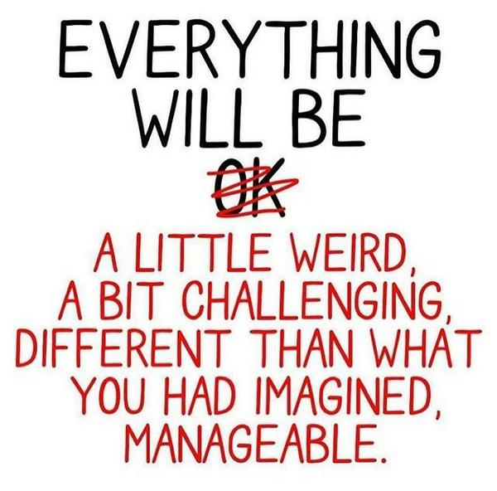
Agenda
Course Orientation
Who is your instructor?
What will you learn?
How will you earn college currency?
Notes:
these slides will be available to you
That does not mean you don't have to take notes
Your notes are not for the data and info you hear and see –
Write down your questions, topics of interest, topics that you want to investigate further.

Slide 3
Agenda
Lecture: Storing and Organizing Data
If you had it all, where would you put it?
Visual Studio IDE introduction
VS is the development tool of professionals and our school.
School of Software Design & Data Science (SDDS) School of Information Technology Administration & Security (ITAS)
previously... School of Information and Communications Technology (ICT)
Notes:
because "School of Information and Communications Technology" (SICT) was not a long enough name, it was split in two schools in August, 2019
Our School of ICT alone was bigger than the universities of New Brunswick, Winnipeg, Laurention, and many others. Also, bigger than the colleges of St. Lawrence, Cambrian, Sir Sandford Fleming. Now, with about half of our 7,500+ students in either SDDS or ITAS, each of our sub-schools are bigger than Lambton, Confederation, Loyalist, and 3 other Colleges…as well as St. Francis Xavier, Acadia, Nipissing, OCAD and many other Universities.
SDDS = the school of the acronymic palindrome
https://www.ontario.ca/data/college-enrolment
https://www.univcan.ca/universities/facts-and-stats/enrolment-by-university/

Slide 4
Agenda
Activity:
Visual Studio IDE programming demo in C
File naming and file extensions
Working with USB drive and/or local drive while doing common file and folder operations

Slide 5
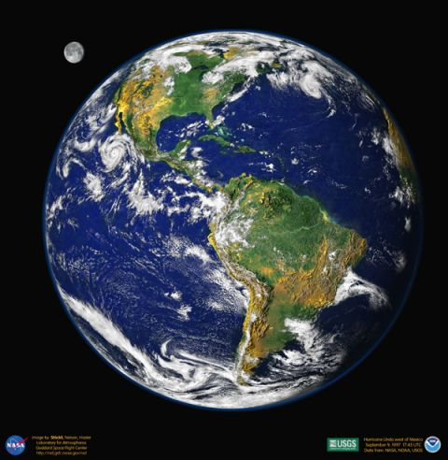
Goals of Computer Principles for Programmers
CP4P CP4P
UNIX Linux
Programming
with C
Notes:
Image from https://apod.nasa.gov/apod/ap000420.html
C programming and Unix/Linux courses focus on detail level technical skills.
CP4P offers context for C & *nix skills in the business and ICT worlds.
CP4P is the "big picture" course. We cover many things that the ICT industry expects programmers to be aware of and things that help you be a better programmer. C programming and Linux/Internet courses focus on detail level technical skills. This course hopes to help you put those skills in context within the business and ICT worlds.
Computer Principles for Programmers offers global concepts in ICT and a view into the things a professional programmer knows in addition to how to write programming code.
What is a professional? Someone who gets paid? One insightful consultant described it as "a professional is someone who does a good job even when they don't want to."
All programming students are also all professional programmers (yes, the money is going in the wrong direction): you are paid, paid in marks, but paid nonetheless. So, you are now a professional.

Slide 6

Ultimate Goal of CP4P
Know ICT terminology and concepts so you can nod expressively during a job interview.
Notes:
One objective in this course is conveying the terminology and concepts of ICT so you can nod like you know what they are talking about during a job interview.
That is why our quizzes are closed book. Dragging those answers up from memory is where they will come from during your conversations with ICT professionals.
https://www.shutterstock.com/search/job+interview+cartoons

Slide 7
Goals of CP4P
Professional programmers do more than just code.
Know current trends and concepts of Computer Systems
Problem identification, solving, and communication
Have facility with IDEs, different User Interfaces, Number Systems, File Compression, Backups, Versioning, Networks & Cloud Computing, Security, Project Management.
Know of Licensing, Regulations, Intellectual Property (IP).
Windows operating system (OS) is used as a template
Notes:
You do not need a personal Windows machine to be successful at Seneca. Our programs cover all major Operating Systems (IBM, *nix, Windows, with some Apple specific courses); Seneca labs give you access to all OS flavours. There will be times when it is necessary to work on the native OS.
RE: IDEs
There is a Visual Studio Code for all platforms and "Visual Studio for macOS" but neither is the full Visual Studio IDE (Integrated Development Environment)
https://www.quora.com/Which-is-better-the-Visual-Studio-Community-2017-or-the-Visual-Studio-Code-2017 VS Community is a professional, enterprise-grade IDE. It is the IDE most used in industry because it is the best there is. The difference between the Community and Professional versions is the licencing. Community is for individuals, or Open Source development, or small scale consultancies. Professional is for "enterprise" size organizations which Microsoft defines as either >250 PCs or users, or >USD$1M annual revenue. VS Code is a modern lightweight text editor similar to Sublime Text, Atom and Brackets. It’s a great editor [that] is much faster than the heavy, full-blown Visual Studio. However, … its functionality pales in comparison.
Apple macOS users: Create a VM that OS is windows, then install the Visual Studio Community and choose the option C++ to install during the VS installation
Macs are lovely and have certain vertical market advantages but are not generally used in business; Mac's North American PC market share (consumer and business) is ~13% and ~7% worldwide (per Gartner and IDC research).
From Microsoft: "If you just want a lightweight tool to edit your C++ files, VS Code has you covered but if you want the best possible experience for your existing Visual C++ projects or debugging on Windows, we recommend you use a version of Visual Studio such as Visual Studio Community IDE." see https://visualstudio.microsoft.com/vs/community/
https://social.msdn.microsoft.com/Forums/en-US/ef99e9f5-2a48-423b-b6c0-fa5617d7c63d/how-do-i-get-c-to-work-on-visual-studio-for-mac?forum=visualstudiogeneral
https://docs.microsoft.com/en-us/dotnet/core/tutorials/using-on-mac-vs

Slide 8
Course Format and Evaluation
Quiz on previous week’s concepts
ICT News of the Week
Weekly Lecture & Activity
Final Assignment – Groupwork

Slide 9
Weekly Quiz
Class begins with a 15-minute quiz on last week's topic and activity.
Done on-time and in class online
10 quizzes, best 8 count
40% of course grading, 5% each.
When life happens, you have options. You can ignore two quizzes.
Notes:
Quiz is CLOSED book, OPEN mind. The objective is to have enough in your head to have a conversation about ICT. The person you talk to might be your boss, your client, your end user, or your colleague. They won't be impressed if you take out your phone and google the basics. It is OK to say, "I don't know" but only after you have talked about things you do know.
You must begin the quiz during the first 10 minutes of class else you have missed the quiz. Be on time for the meeting.
No one in business is ever late for a meeting. If you arrive after the start time and the boss is not there yet, you are not late. If you arrive after the start time and the boss IS there, you don't go in.

Slide 10
ICT News of the Week
4 students each present an ICT news item
3 to 4 minute presentation incl. Q & A
Graded item worth 4% of course
Subscribe to a news service
Build your ICT vocabulary
Learn the TLAs
Your future employers read and make the news
Notes:
ICT is Information and Communications Technology. It used to be just "I–T", Information Technology, until Communications became an essential part. E.g. How do you feel about using a computer or phone without an Internet connection?
ICT is a TLA. TLA is an in-joke: Three Letter Acronyms, There are lots of TLAs -- a few Two Letter Acronyms, but no FLAs -- Four Letter Acronyms, there are only xTLAs – eXtended Three Letter Acronyms (also an in-joke).
In 1988, in a paper titled "On the cruelty of really teaching computer science", eminent computer scientist Edsger W. Dijkstra wrote "Because no endeavour is respectable these days without a TLA ..."
When someone asks what does ICT, CPU, FPU, AI, USB, or RAM mean, you say, "It's a TLA." If anyone laughs, you know they are part of the ICT club. For the others who are frowning, you apologize for the ICT industry being full of TLAs, then explain TLA and the TLA itself—without using more TLAs.
All vertical industries have their own shorthand TLAs. Just don't use them to impress and intimidate others.
https://en.wikipedia.org/wiki/Three-letter_acronym
http://www.nickh.org/computer/glossary.html
Also see http://www.catb.org/~esr/jargon/index.html
4 students each present a topic in weeks 2 – 6 and 8 – 10. Students will be assigned weeks. Be prepared a week ahead so if one of your colleagues experiences a big dose of the gods' humour this week, you can be a hero by stepping in for them and they can take your spot next week.

Slide 11
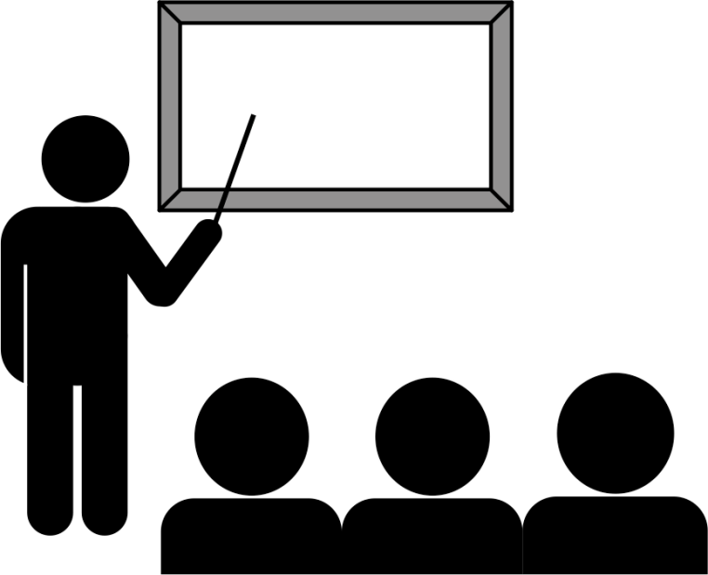
Weekly Lecture
Lectures deliver the content of the week's topic and activity which will become next week's quiz.
Ask questions during the lecture.
Put away away your smartphone. (It makes you stupid .)
Take a break when you need one.
Face-to-face is the best interface, but for now, we’ll have to use MS Teams and BigBlueButton.
Notes:
The social rules in class are more relaxed than in some environments but there are more rules IRL than in the online world. E.g. a rule you don't often see followed online: Be respectful of others. Treat the lecture as a business meeting where the client is telling you about their business and their requirements. Your job is to fulfill those requirements within the next week.
https://www.theglobeandmail.com/technology/your-smartphone-is-making-you-stupid/article37511900/
https://news.utexas.edu/2017/06/26/the-mere-presence-of-your-smartphone-reduces-brain-power
https://www.psychologytoday.com/blog/the-athletes-way/201706/are-smartphones-making-us-stupid
https://hbr.org/2017/04/a-new-more-rigorous-study-confirms-the-more-you-use-facebook-the-worse-you-feel
https://hbr.org/2018/03/having-your-smartphone-nearby-takes-a-toll-on-your-thinking
https://www.theglobeandmail.com/opinion/article-squirrel-we-must-zero-in-on-improving-our-attention-management/

Slide 12
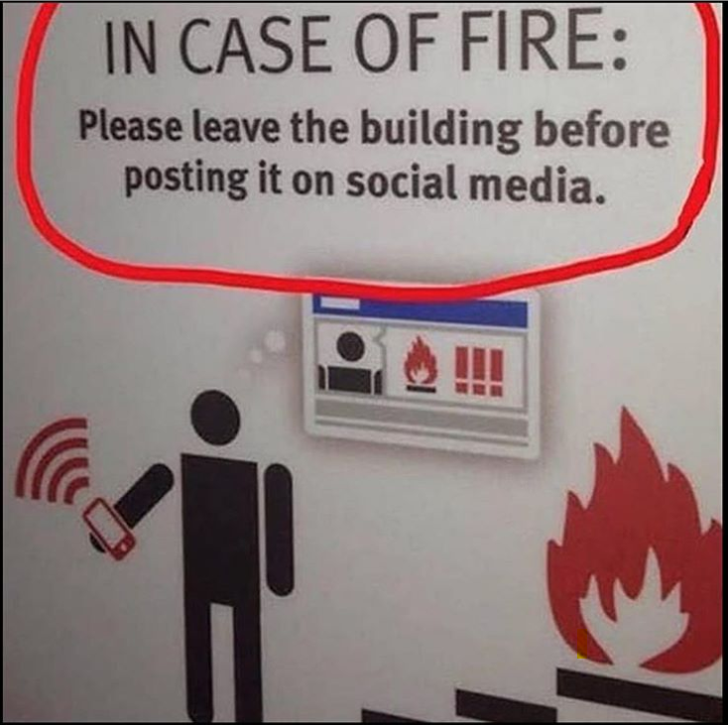
Weekly Lecture
Your
smartphone makes you stupid .
Notes:
The social rules in class are more relaxed than in some environments but there are more rules IRL than in the online world. E.g. a rule you don't often see followed online: Be respectful of others. Treat the lecture as a business meeting where the client is telling you about their business and their requirements. Your job is to fulfill those requirements within the next week.
https://www.theglobeandmail.com/technology/your-smartphone-is-making-you-stupid/article37511900/
https://news.utexas.edu/2017/06/26/the-mere-presence-of-your-smartphone-reduces-brain-power
https://www.psychologytoday.com/blog/the-athletes-way/201706/are-smartphones-making-us-stupid
https://hbr.org/2017/04/a-new-more-rigorous-study-confirms-the-more-you-use-facebook-the-worse-you-feel
https://hbr.org/2018/03/having-your-smartphone-nearby-takes-a-toll-on-your-thinking
https://www.theglobeandmail.com/opinion/article-squirrel-we-must-zero-in-on-improving-our-attention-management/

Slide 13

Weekly Activity
Weekly Activity is your investigation of the week's topic
Activities can be accomplished in class.
Submit by end of class day + 2
Of 11 activities, the best 9 count for 36% of course grading, 4% each.
When life happens, you have options. You can ignore two activities.
Notes:
There will be approximately 1 period of time, about 50 minutes) for you to explore the activity. Doing it in class means you can talk about it with others and your instructor as you do it.
Activities are due via submission through Blackboard (my.senecacollege.ca) by 23:59 of the next calendar day. This is to give you flexibility in balancing your workload with other courses. It does not mean procrastinate for a day.

Slide 14

Final Assignment
Done in a group/team
Must be completed to pass the course
20% of total course marks
Completed during last 2 weeks of the term. Class time is team time.
No exam!

Slide 15

Graded Work
Content | %
Quizzes (8 of 10) | 40%
Activities (9 of 11) | 36%
ICT News Item | 4%
Final Assignment | 20%
Total | 100%
min 50% overall per college policy
min 50% in each of Quiz and Activity portions
submit Final Assignment
Course Information and Announcements for details

Slide 16
Success is not goals, it's process.
Attend class. Pull from SICT.ca, web sites do not push.
Follow ICT tech news and come prepared to discuss.
Take notes. ICT professionals do this in every meeting.
TL;DR not an option. Follow all steps in the activity.
Discuss during the activity. Talking is part of learning.
Talk all you want but don't copy anything.
Attend class, every week. Focus on process, not goals.
Notes:
Student learning recommendations
Review the entire activity / lab / workshop / assignment immediately after the lecture to understand the objective, the process, and the deliverables
discuss with student colleagues
ask for instructor's help as needed
Even if you don't complete the activity during class/lab time, by reviewing the entire activity before you do it later, your brain will be better prepared when you do work on it.
review slide deck, textbook, handouts, lecture resources, and your own notes for 10 minutes the next day, 5 minutes the next week, 2.5 minutes the next month, and you will never have to cram for an exam.
review things the night before a quiz or test.
Sleep is important for learning, memory consolidation, and many other things, just like Mom said.
Go to bed at a consistent time and get a full night's sleep. Do this regularly and you will rarely need to set a morning alarm.
Staying up late borrows time from tomorrow—with interest. After a full night's sleep, you will get more done in less time. Sleep deprived people get sick more often than the well rested, and the well rested with a consistent sleep schedule have greater academic success. Want to be 10 – 15 IQ points smarter? Do what your Mom said.
Attend class. It has been said that "80% of success is showing up."
Pull is the business world. Web pages are pull – you must load a page and read it. Email is pull. You may not know if there is new email until you look or PULL from the server. Unlike the Twitterverse which is always trying to get your attention by pushing new events to your phone, you have to consciously pull at Seneca and when working in the industry.
3. Taking notes is not for recording the factoids of a lecture, it is for making meaning.
Take notes during the lecture.
Even though learning resources are available to you on demand, it does not mean you don't have to take notes.
Your notes are not for the data and info you hear and see, your notes are to make meaning, mind maps, mental constructs, and understanding of the material.
Take notes for things important to you. What questions do you want to ask? What interests you? What do you want to look further into? What matters? Why does it matter? When will it matter?
Research says even just doodling during a lecture will help you focus on the proceedings.
All business people, yes all, go into a meeting with pen and paper, and come out with key insights and action items.
4. Thoroughly read all steps in the activity. TL;DR is not an option in the ICT business. They pay us to read the manuals.
5. "Talk all you want, don't copy anything." Giving or getting anything to/from another student that will be/has been graded is plagiarism possibly on both the giving and getting sides. In this course, that means quiz answers, activity submissions, and final assignment components. Please discuss anything and everything, just don't exchange quiz answers, activity doc files, program source code, or anything else that is marked by an instructor in any course.
All the answers to just about everything in life are out there on the Internet. In some education cultures, the objective is to find the answer. However, in this course and others, having the answer is not meaningful unless you worked it out for yourself – that is what matters. It's the journey, not the destination. If you need help understanding the problem, you can ask for it. If you need help working out the solution, you can ask for it. If you need more time, you can ask for it (as long as you've been working on the problem before delivery was due).
6. Goals and dreams are great to have. Goals are what psychologists call Delayed Gratification: invest in short term pain for long term gain.
Your commitment to come to Seneca was huge. It will have long term value. Your goal to complete your program and learn good things gets you started. It is hard to start something so big, and yet, you’ve done that – you are here. But it isn't enough.
So why don’t goals work? Delayed Gratification takes too long, that’s why. Hard work often pays off after time, but laziness always pays off now. What works? Process works. Having a goal to do a marathon does not work. Diligent training and wearing out many pairs of running shoes…that works. Getting up early to go to the gym or run 5 days/week works.
Process is planning your novels while on public transit – that works. Process is writing your novel in longhand whenever your baby daughter sleeps – that works. Keying it on a typewriter—repeatedly—works. The process of doing that for 5 years got the novel written. Spending a year being rejected by agents, then finding one who sent the manuscript to 12 publishers, who all rejected it, all the while training as a teacher in case the novel didn't sell…that works. The 13th publisher, Bloomsbury, agreed to take a chance on Harry Potter and the Philosopher’s Stone publishing it with low expectations. That’s how J.K. Rowling got the first Harry Potter book out into the world. Process got it written. Process got it published. But just having a goal to sell over 500 million books and become the richest author in history does not get it done. Success is about process; that's what is meant by "showing up."
https://getpocket.com/explore/item/how-to-beat-procrastination-backed-by-science
These and other notes to this effect are found in the Class Standards document (under Course Information in Blackboard )
Attend all classes and “be on time.”
“Silence” audible devices or put your call on speakerphone so we can all participate.
Don’t work on the activities or assignments during the lecture! Focus on the task at hand – “don’t multitask.”
Review previous lecture notes to prepare for the quiz of each week, the night before class.
Submit all graded work on time.
Even if you know some of the material already, we are going to emphasize the “professional practice” of those concepts. So, “be patient and pay attention all the time.”
“Keep quiet” during the quiz, news, and lecture and “don’t distract others.”
The ultimate goal is to get you ready for the job market. So, get in the habit of being “punctual and respectful of others.” Treat your professor as your boss/manager and treat your classmates as your colleagues.
During the quiz, looking at others monitors and/or talking before everyone is done is considered as “cheating.”
Check your grades and if you have any concern about them for each week, talk to your professor “no later than the following week.”
You are responsible to “continuously and regularly check and follow” your Seneca emails for this course. There might “always” be important messages!
Based on the emails your professor receives, it might take some time for him/her to reply your email; “be patient!”
If you miss a class, your professor is not going to re-teach that to you (even during office hours). You are responsible for your learning. Back each other up by sharing your notes (but NOT graded items).
Don’t rush to leave the class early; instead, “concentrate on studying the steps needed to be done and doing them right!” Also, there might be “some directions or explanations needed from your professor before doing the activities”. Talking about the issues with your colleagues is a great way to make learning easier.
Quizzes and activities are to be done “in class, on-time, and through Blackboard.” You can’t email them or do them after the class or out of their time. Also, “be careful of your Blackboard submissions and double check everything” before that.
You have the right to ask help from your instructor or other students or search the web to find the answers to questions in the activities, but the “ultimate answers should be yours.”

Slide 17
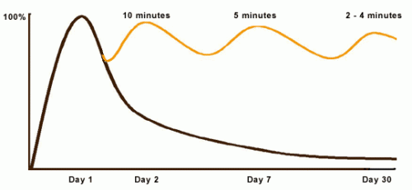
Curve of Forgetting, Sine Wave of Remembering
Review = Retention = Quiz marks
Review = Retention = Test marks
See U of Waterloo and Ebbinghaus
Notes:
Review these lecture notes tomorrow, then 6 days from now before you go to sleep. On the 7th day from now, you'll do fine on the quiz.
https://www.google.ca/search?q=Ebbinghaus+forgetting+curve
https://uwaterloo.ca/campus-wellness/curve-forgetting
On day 1, at the beginning of the lecture, you go in knowing little of what might be said ( 0% baseline). At the end of the lecture you know 100% of what you know, however well you know it (where the curve rises to its highest point).
By day 2, if you have done nothing with the information you learned in that lecture, didn't think about it again or read it again, you may have lost 50%-80% of what you learned.
By day 7, we remember even less, and by day 30, we retain about 2%-3% of the original hour. It's pretty much gone…you know this. Have you ever wondered when taking a quiz or writing an exam, "Where did this question come from?"
You can change the shape of the curve! Reprocessing the same chunk of information sends a big signal to your brain to hold onto that data. When the same thing is repeated, your brain says, "Oh - there it is again, I better keep that." When you are exposed to the same information repeatedly, it takes less and less time to "activate" the information in your long term memory and it becomes easier for you to retrieve the information when you need it.
Here's the process:
after a good night's sleep and within 24 hours of getting the information, spend 10 minutes reviewing and you will raise the remembering curve to almost 100% again. A week later (Day 7), it takes 5 minutes to "reactivate" the same material and raise the curve back up. By Day 30, your brain will need 2-4 minutes of review to not only remember what you knew on Day 1 but will likely understand more than you did then. During the test, you'll think, "Hey, I know where that question came from…"
Often students feel they can't possibly make time for a review session every day in their schedules – students have trouble keeping up as it is. However, this review is a pro-active investment of less than one-half hour of your time. If you don't review, you will need to spend 40-50 minutes re-learning each hour of material later. So, if you don't have time now, exactly when are you going to have that kind of time in the future when things get even busier?

Slide 18
Our School of ICT has found…
In the beginning …
By the end …
“Comparison is the thief of joy.” — Theodore Roosevelt
How did you learn to ride a bicycle?
Notes:
In the beginning of the program, students vary widely in their computing "literacy" and overall programming abilities.
By the end of the program, there is little difference. Entrance experience is NOT correlated with graduating GPA.
Humans naturally compare themselves to others: it's good for self-motivation but bad for self-evaluation/esteem. “Comparison is the thief of joy.” —Theodore Roosevelt
How did you learn to ride a bicycle? …How? Not by falling off, that was learning how NOT to ride a bicycle. You learned by getting on again.
Lots of people obviously already knew how to ride a bicycle – you didn't – but you didn't compare yourself unfavourably to them. Why not?
Everyone accepts riding is a skill no one is born with; it has to be learned, that it is OK to fall off, that if you are willing to get back on again, you will learn to do it. How many people do you know who ever said, "Yeah, I tried bicycle riding but it wasn't for me. I don't think I'm cut out for it so I just walk."? Hmmm? How many? How long did it take to learn? Weeks? Not likely. Days? Hours? In any case, it's likely that learning happened much sooner than you thought it would when you started.
https://www.theglobeandmail.com/life/facts-and-arguments/i-am-25-years-old-and-i-cant-ride-a-bike/article14147665/
https://en.wikipedia.org/wiki/Social_comparison_theory
individuals evaluate their abilities by comparing themselves to others in order to reduce uncertainty in these domains, and learn how to define the self. (Festinger, 1954)
https://www.psychologytoday.com/basics/social-comparison-theory
http://www.cnn.com/2015/10/27/health/comparing-yourself-with-peers/index.html
Galinksy and Schweitzer (2015) write that "when it comes to using social comparison to boost your own motivation, here is the key rule to keep in mind: Seek favorable comparisons if you want to feel happier, and seek unfavorable comparisons if you want to push yourself harder."

Slide 19
For later…
Reshma Saujani
TED Talk: teach bravery not perfection. ~5M views
Founder of Girls Who Code
Author of
Brave, Not Perfect (2019)
Girls Who Code (2017) NYT bestseller
Women Who Don't Wait in Line (2013)
Notes:
Highly recommended for both genders. Her TED talk is worth 12 minutes of your time. These slides will be available later today.

Slide 20
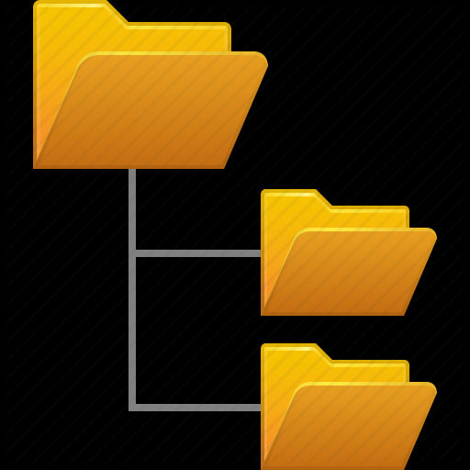
If you had it all, where would you put it?
Storage devices. Drive / root, Folder / Directory, File
Notes:
This is the start of the agenda question, If you had it all, where would you put it?
Information is usually stored in an organized, hierarchical fashion.

Slide 21
Computer Storage
Volatile memory: needs constant power to retain data
RAM for primary storage. Fast – supports CPU/FPU/GPU/TPU calcs
Non-volatile memory: stores data persistently without power
Many types of secondary or mass storage. Slowly transferred to RAM
CPU
fast
RAM
slow
File: CourseSections
FPU
CPR101 SAA Mon 1-3
R e c o r d s
Course | Sec-tion | DoW | Period
APS145 | SAA | TUE | 3-4
CPR101 | SAA | MON | 1-3
IPC144 | SAA | TUE | 6-7
IPC144 | SAAL | THU | 7-8
ULI101 | SAA | MON | 5-6
ULI101 | SAAL | WED | 2-3
GPU
Notes:
In general, you probably know this already. However, the terms volatile, non-volatile, primary, secondary, and persistently should be clear in a programmer's mind.
RAM – Random Access Memory
CPU: central processing unit, or processor. Runs your computer. general workhorse. Capable of many different operations and memory transfers
FPU: Floating Point Unit.
GPU: graphics processing unit, or graphics card. Runs your graphics: video rendering, image rotation, shadowing, compression, … GPU’s are tuned for massively parallel calculations for use in video and image processing. Machine learning and crypto enthusiasts used the GPU parallel math capabilities to speed up their algorithms – faster on a GPU than on a CPU
TPU: tensor coprocessing unit. Runs the ASIC for neural network machine learning. accelerate neural computations (matrix-matrix and vector-matrix), cheaper and faster than GPU for Machine Learning -- deep learning (TensorFlow) and neural networks
ASIC: application specific integrated circuit. A customised circuit for a very specific use (rather than general purpose).
https://www.quora.com/How-can-CPU-FPU-and-GPU-be-explained-compared-and-contrasted https://www.quora.com/How-different-is-a-TPU-from-GPU
ROM – Read Only Memory
WOM – Write Only Memory (kidding)
Persistently = permanently.
A file or set of data may be quite large and will not always fit into RAM. The CPU works only on portions of a file at a time, i.e. data elements (size & type, e.g. char or int) are used in RAM which come from fields in a record; a file contains many records which have similar information. E.g. a file of Seneca courses contains a record for each class; each record contains fields for course code, section code, room number, instructor, day-of-week & from/to times, … A file is a grouping of related records.
https://en.wikipedia.org/wiki/Volatile_memory
https://en.wikipedia.org/wiki/Non-volatile_memory
Relative performance from https://www.enterprisestorageforum.com/storage-hardware/ssd-vs-hdd-speed.html
If HDD is 10ms, SSD would be 2.25ms, DRAM would be 0.00001ms or 10ns to 0.0001ms or 100ns, CPU cache would be 0.00001ms or 1ns to 0.00001ms or 10ns, CPU register would be 0.000001ms or 0.11ns. Overall, DRAM is ~100,000 to 1M times faster than HDD. CPU cache is an order of magnitude faster than DRAM, and CPU registers are an order of magnitude faster than CPU cache.

Slide 22
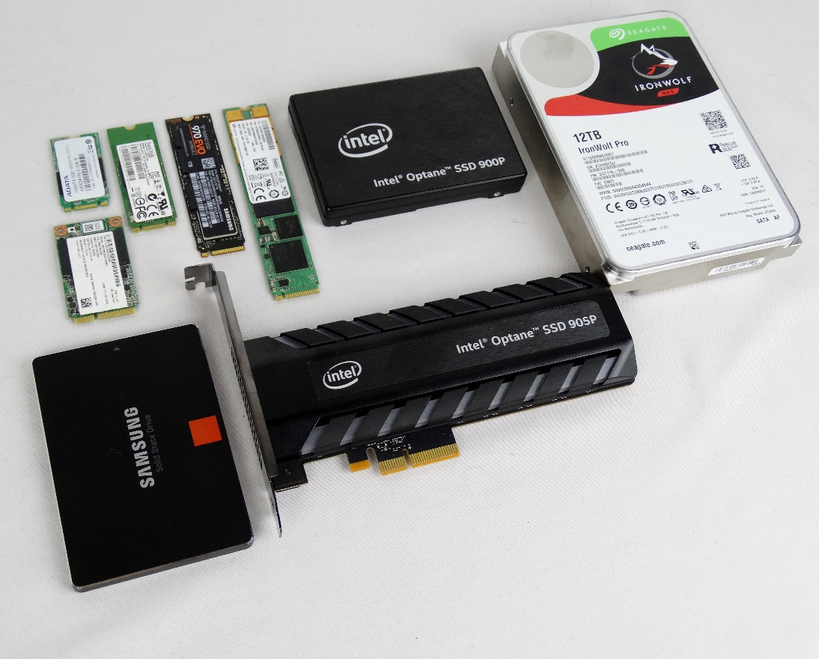

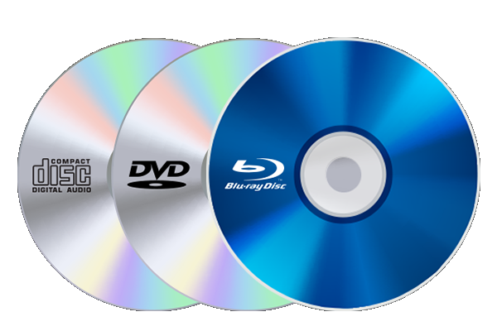

Persistent storage devices
SSDs
LTO
Linear Tape Open
HDD
USB
CD DVD BD
Notes:
For PCs and small servers: HDDs and SSDs can be mounted internally for high performance or via USB flash/portable/external for simple backups.
SSDs and HDDs are used in all sizes of systems. High capacity Blu Ray (BD) discs and LTO are used in enterprise backup systems.
The term "enterprise" when used in the ICT context means large organizations and/or large-scale systems.
See https://en.wikipedia.org/wiki/Enterprise_software for a general sense of the term's use.
USB attached devices are not used in enterprise data centers but are very handy for casual personal and small server use.
USB drives have low performance but high flexibility. Flash / pen / thumb drives are small cost & small capacity, low performance but highly portable, robust, and convenient. But are high cost per GB.
"portable" drives powered by the USB connection have larger capacity than flash drives but smaller capacity than externals.
"external" drives are larger capacity units needing their own power supply because they usually run HDDs within the enclosure.
https://en.wikipedia.org/wiki/USB_flash_drive
https://www.premiumusb.com/blog/whats-in-a-name-usb-flash-drive-synonyms
https://www.premiumusb.com/blog/how-long-can-usb-drives-last
http://searchstorage.techtarget.com/definition/USB-drive
https://www.makeuseof.com/tag/hard-drives-ssds-flash-drives-how-long-will-your-storage-media-last/
Usually disk refers to magnetic storage, disc refers to optical storage.
Consumer discs used as distribution media are "stamped", i.e. replicated, in mass quantities. Industry use of discs are individually burned.
CD – Compact Disc, originally developed for music distribution, 700MB
DVD – Digital Versatile Disc, used for video distribution replacing VHS tape media, thus the Digital Video Disc confusion.
BD – Blu-ray Disc. 25GB blank BD-R discs are affordable but have insufficient capacity for use "at scale" in large enterprises. 100GB BD-Rs used in industry backup/storage/archive systems.
For distribution purposes: You can no longer assume that everyone has a general purpose optical disc reader or, if they do, that it can read BD discs.

Slide 23
Persistent storage – Online
Online as in high performance & availability – not a generic/network term
from fastest to slowest for high transaction loads & database
Direct Attached Storage – within same case or frame
SSD – Solid State Drive – high capital expense, low operating expense
HDD – Hard Disk Drive – low cap-ex, high op-ex.
Limited scalability: constrained by drive size; physical space within case or frame
SAN – Storage Area Network – block-level data storage of any size
virtual drives. scalable. functionally similar to DAS but independent of drive capacity.
provides storage for rack / blade diskless servers, uses special network connection.
High Tier Cloud – server needs sophisticated private network interconnection to cloud.
not over general Wide Area Network or public Internet
AWS S3, Google Cloud, MS-Azure – low cap-ex, very high op-ex. Scales quickly.
NAS – Network Attached Storage, file-level serving to any OS
not for transaction or database processing.
Notes:
Since the Internet became ubiquitous, 'online' has been synonymous with a user being on a network.
Online means more than that. Slides are talking about hardware systems which is a different context. The term 'online' has been used in IT since the early days of computing to indicate devices directly/closely attached to the main system.
Online drives listed from highest to lowest performance. WHY are each type high/low cap-ex & high/low op-ex ?
Capital vs operating expense: capital is acquisition cost – purchasing a device, SSDs are currently 6 – 10 times the capital cost of HDDs per GB. Operating cost is the electricity to run the device which creates waste heat and the climate control system which gets rid of the heat generated by the device running.
https://en.wikipedia.org/wiki/Cloud_storage
DAS Direct attach = storage devices installed within the computer on a data bus connected to a motherboard or disk controller, also known as 'internal' drives. Mostly used in PCs and smaller servers –limited by physical drive bay space in standalone systems.
https://en.wikipedia.org/wiki/Direct-attached_storage
https://www.cnet.com/how-to/digital-storage-basics-part-1-internal-storage-vs-memory/
SAN Storage Area Network = block-level storage devices accessed through a dedicated high speed connection with specialized protocol optimized for data transfer over a network, (independent of local area network traffic and generic network protocols). Functionally, it is similar to DAS (not NAS); it provides what appears to be a DAS drive to an attached server. https://en.wikipedia.org/wiki/Storage_area_network
Highly scalable meaning the system can grow to meeting increasing demands: add more storage to support more servers, higher/faster transaction loads, more raw capacity. https://en.wikipedia.org/wiki/Scalability
NAS Network attach = storage devices accessible through the local area network. Range from industrial/enterprise size systems down to a Western Digital "My Cloud" device plugged into your home router. NAS is a file-level computer data storage server on a LAN providing data access to a heterogeneous group of clients using various file sharing protocols. NAS file systems are independent of the platform that originally sent or is requesting the data. E.g. Apple, Windows, Linux, IBM systems, which all have different file systems, can send files to an NAS which can send a file to a different (heterogeneous) system – no more platform incompatibilities. https://en.wikipedia.org/wiki/Network-attached_storage
In large data center, racks of diskless servers are connected to NAS and SAN systems.
High Tier Cloud needs high bandwidth + low latency private network connection to cloud provider.
e.g. "Amazon S3 now provides increased performance to support at least 3,500 requests per second to add data and 5,500 requests per second to retrieve data" – this does not happen through your regular ISP connection.
https://aws.amazon.com/s3/storage-classes/
https://docs.aws.amazon.com/AmazonS3/latest/dev/optimizing-performance-guidelines.html
https://aws.amazon.com/about-aws/whats-new/2018/07/amazon-s3-announces-increased-request-rate-performance/
https://cloud.google.com/solutions/data-management
https://cloud.google.com/interconnect/docs/how-to/choose-type
https://cloud.google.com/hybrid-connectivity/
HDD Hard Disk Drive – 2.5-inch drives for laptops; 3.5-inch drives for desktops, servers, SAN, and NAS. A motor drives a disk with platters coated in magnetic material. https://en.wikipedia.org/wiki/Hard_disk_drive
High performance HDDs are seeing less use in data centers because i) they have both high cap-ex and higher op-ex than standard 5400 RPM drives and ii) their price/performance IOPS cost advantage relative to SSDs is falling.
https://en.wikipedia.org/wiki/Hard_disk_drive_performance_characteristics https://en.wikipedia.org/wiki/IOPS
http://royal.pingdom.com/2010/02/18/amazing-facts-and-figures-about-the-evolution-of-hard-disk-drives/
SSD Solid State Drive – 2.5",mSATA,M.2 form factors Integrated Circuits store data without mechanical moving parts. SSDs work by magic. As in "Any sufficiently advanced technology is indistinguishable from magic." Science fiction writer Arthur C. Clarke's third law appearing in "Hazards of Prophecy: The Failure of Imagination." (1973) https://en.wikipedia.org/wiki/Clarke%27s_three_laws
SSDs are more reliable than HDDs up to a point. SSDs will retain data for ~10 years but can wear out earlier after too many write cycles. SSDs may offer a lower TCO – Total Cost of Ownership for enterprises needing high performance access to data (Not necessarily high performance writing of data.).
https://en.wikipedia.org/wiki/Solid-state_drive
Client vs Data Center/Enterprise SSDs https://youtu.be/xtYWw1mNn8s
https://hostadvice.com/hosting-guides/ssd-vs-hdd-hosting/
https://www.computerworld.com/article/3297957/an-ssd-designed-for-greater-toc.html (really just a paraphrased Samsung marketing pitch for their SSDs)
https://www.storagereview.com/ssd_vs_hdd
https://www.google.com/search?q=ssd+vs+hdd+tco
https://www.enterprisestorageforum.com/storage-hardware/ssd-vs-hdd.html
https://www.pcmag.com/article/297758/ssd-vs-hdd-whats-the-difference
https://www.backblaze.com/blog/how-reliable-are-ssds/

Slide 24
Persistent storage – Nearline & Offline
Nearline & Offline (cold storage)
lower performance & availability, primarily for backup & archiving
very low capital and operational expense relative to Online
Linear Tape-Open (LTO-8 12TB) media
Optical Disc (Blu Ray 100GB) media
Nearline (tape / optical library, MAID), Offline (tape, optical)
Near-line = robotic mounting of tape/disc or Massive Array of Idle Drives
Offline = manually retrieve tape/disc from physical storage and mount
Cloud cold storage: AWS Glacier, GCS Coldline, BackBlaze B2
Internet file serving: OneDrive, Dropbox, iCloud, Drive, AWS
Notes:
BACKUP
LTO-8 12TB tape ~30TB highly compressed data (i.e. not photos, not video, not FLAC audio) cost ~$150 / cartridge expected to fall to ~$60
https://en.wikipedia.org/wiki/Linear_Tape-Open
Blu Ray 100GB discs ~$1 in quantity (in the same capital cost ballpark as LTO tape cartridges and similar operating expense)
MAID Massive Array of Idle Drives used in Cloud services for backup and storage of data which rarely changes.
LTO, optical, and cloud cold storage systems/services – each claim to be the cheapest compared to the other systems/services.
Facebook has been using robotic optical for cold storage for a few years.
http://www.digitalpreservation.gov/meetings/documents/storage14/Kestutis_Patiejunas_Facebook_FreezingExabytesOfDataFacebooksColdStorage.pdf
Cloud cold storage backup is very low op-ex but restoring from backup is high op-ex and slow! The less you pay to store, the higher the cost and longer it takes to restore.
Internet file serving: OneDrive / Dropbox / iCloud / Google Drive is similar to, but not as fast as a local NAS. These services fit between Online and Nearline in terms of performance and cost.

Slide 25
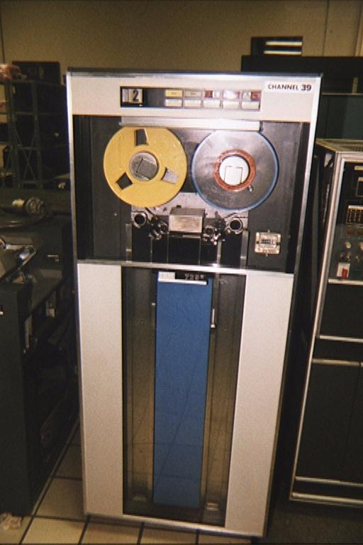
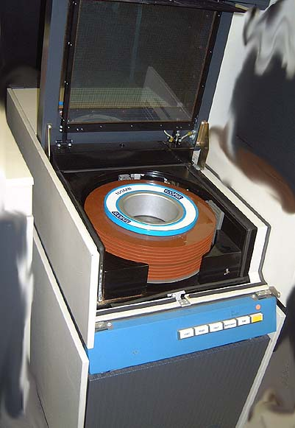
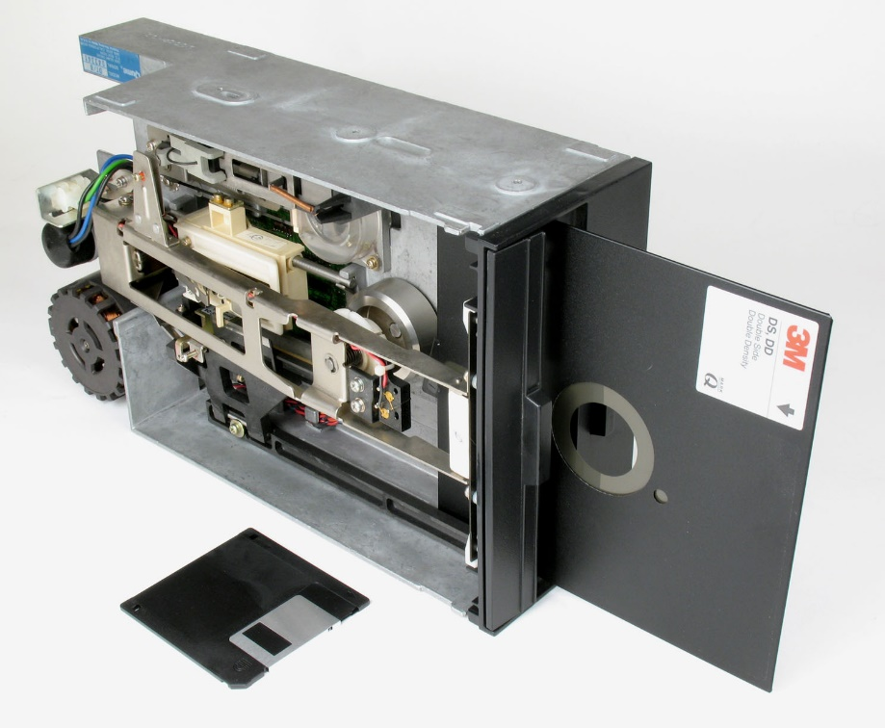
Persistent storage devices historically
Storage media were mounted to "drives" used by a "machine"
Tape Drive
Disk Pack Drive
Diskette Drive
Notes:
From the 17th to 19th centuries, a computer was a human whose occupation was to make mathematical calculations with the help of various machines, from the abacus to the calculator, invented to make the human computer's life easier. In the 20th C, the term computer slowly migrated from the human to the machine. As calculators became less and less mechanical and more and more electronic and general purpose programmable, those devices came to be known as the computers. The humans became programmers and users. But nerds, geeks, and techies kept calling their computers plugged into wall sockets "machines" likely to separate themselves from users who, not knowing any better, called such things PCs and servers.
Devices are attached to your "machine" as in Turing machine (1937) – a theoretical computer and as in "calculating machine" (1897) used by "computers", i.e. people who calculate (from the Latin 'computare'). http://www.latin-dictionary.net/search/latin/computare)
https://books.google.ca/books?id=J4i3zV4vnBAC&pg=PA97&lpg=PA97&dq=Oxford+Dictionary+of+Word+Origins+computer&source=bl&ots=aFsbRKzNte&sig=YnDDkmw8zN7CEi4mo2AQ-kpLqEE&hl=en&sa=X&ved=0ahUKEwjMjcTMlMbYAhXB7YMKHeg7BaUQ6AEIbTAN#v=onepage&q=Oxford%20Dictionary%20of%20Word%20Origins%20computer&f=false
https://english.stackexchange.com/questions/335105/etymology-of-the-use-of-drive-to-refer-to-a-digital-storage-medium
HDDs are "hard" versus Floppy Disk Drives used in the 1970s, 80s, (and 90s). The colloquial term floppy distinguished those disks from other disk systems with drives that, since 1956, had been only hard. The original "floppy" term was "diskette" – a little disk – but that 1971 term invented by IBC never got outside the computer room. The IBM PC, introduced in 1981, used FDDs like other microcomputers of the time. HDDs became affordable for personal computers in the mid to late 1980s. By that time, people were used to calling disks "floppys" because of PCs so the term hard disk drive ( C: ) came into use to distinguish them from floppy disk drives ( A: & B: ).

Slide 26
OS mounts a storage device to a Drive
Drive: storage device recognized by Operating System (OS)
OS mounts drives: recognizes hardware & assigns unique identifier C: or D: or E: ... in Windows (mounting is automagic) # mount /dev/sdc1 /media/usb-drive/ in Linux/Unix -hardware- ---- identifier ----
Mounting is the process of making the file system on a storage device accessible to the OS and your applications / software.
e.g. plug in a USB drive
Notes:
Automagic = as programmers, we know hardware and operating systems do things for us but we don't want to know how. Therefore, automagic.
Windows "mounts" a new storage device such as a USB device as a drive and does this automatically. DOS and Windows were designed for end users, Unix & Linux were designed for ICT geeks like you see around you in this room.
https://en.wikipedia.org/wiki/Mount_(computing)
https://www.ibm.com/developerworks/library/l-lpic1-104-3/index.html

Slide 27
What is a File? What is Data?
File: uniquely named space on a Drive. Files contain Data.
Data: a sequence of formatted symbols
Software: encoded machine instructions (data in .exe executable file) compiled from source code (data in a .c file)
Information: data interpreted by software that performs a task
MS Word file: data encodes words and images into an essay or book
Plain Text file: stream of ASCII characters.
<html> markup with a web site’s content (Ctrl-U in a browser to see it)
programming source file's formatted symbols: #include <stdio.h>
Code: human readable instructions for a compiler to generate an executable file.
Comments: explanations for humans to understand the code
Notes:
An operating system (OS) knows where a file is and provides read/write access to that file by application software. Application software expects the raw data in a file to be organized by a format (e.g. rows and columns, lines and characters with syntax and punctuation) in order to represent meaningful information.
Data must be formatted to be useful and meaningful.
What is in a programming language ‘source’ file?
Code: human readable instructions for a compiler to generate an executable file.
Comments: human readable explanations for other humans to understand the code. (most important part)
https://en.wikipedia.org/wiki/Computer_file
https://en.wikipedia.org/wiki/ASCII
https://en.wikipedia.org/wiki/Data_file
https://en.wikipedia.org/wiki/File_format
https://en.wikipedia.org/wiki/Namespace
https://en.wikipedia.org/wiki/Data_(computing)
https://en.wikipedia.org/wiki/Metadata
https://en.wikipedia.org/wiki/Plain_text
https://en.wikipedia.org/wiki/Formatted_text
https://en.wikipedia.org/wiki/Source_code
https://en.wikipedia.org/wiki/Syntax_(programming_languages)
https://en.wikipedia.org/wiki/Executable

Slide 28
Data format == meaning
Words sorted in alphabetic order: a her is man nothing without woman
With Sequence and Punctuation: A woman without her man is nothing.
With same Sequence but different Punctuation: A woman: without her, man is nothing.
Data must be formatted to be useful and meaningful.
so does source code!

Slide 29
What is a Folder/Directory?
file system's hierarchically named cataloging structure
C:\Users\Tim\Desktop\Temp C:\Users\Tim\AppData\Local\Temp
contains Files and/or other Folders / Directories.
help to organize files!
Directories within directories are sub-directories or sub-folders in a hierarchical structure
Windows & Mac OS: directories are known as Folders
Linux/Unix: directories are still called directories
Notes:
"hierarchically named" means you can have more than one of the same file or folder names as long as they are in different folders/directories.
e.g. there are two "Temp" directories in the example. There are probably many README.TXT files on your system in different folders/directories.
You could organize files simply by using really long filenames that completely described their category, purpose, content, and so on. But it is better using directories because humans can be quite good at organizing information hierarchically.
https://en.wikipedia.org/wiki/Directory_(computing)

Slide 30
Path and Filename structure
Windows C:\users\student\CP4P-week1.docx Linux/Unix /users/student/CP4P-week1.docx
drive root
folder directory
sub-folder sub-directory
filename FileName
extension (optional)
Full Path Name is the unique identifier of a file in a system:
[drive|root] / folder / sub-folder(s) / filename.ext
Windows: case-independent with \ backslash separators
Linux/Unix: case-dependent with / forward slash separators
Notes:
A reference to a location in a filesystem is called a path.
A path is the location of a file in a hierarchy of directories.
A full path name from drive|root through directories down to a filename.ext solves the problem of needing unique names for every file on the system:
Files can have the same name when they are in different directories.
A directory is a file system concept, a folder is a graphical user interface metaphor which usually represents a directory. The terms are often used interchangeably.
https://en.wikipedia.org/wiki/Directory_(computing)
https://en.wikipedia.org/wiki/Directory_structure
https://en.wikipedia.org/wiki/Path_(computing)
Unix and Unix-like operating systems use the Filesystem Hierarchy Standard as the common form for their directory structures. All files and directories appear under the root directory "/", even if they are stored on different physical devices.
https://www.howtogeek.com/181774/why-windows-uses-backslashes-and-everything-else-uses-forward-slashes/
DOS 2.0 & Windows uses \ character for C:\directory\*.* because / was already used as switch char for command options. E.g. > dir /s C:\directory
Unix was smart enough to use the "-" hyphen as the command line switch character so had no conflict with / as directory separator.
> ls –R \

Slide 31
File Extensions
A file extension is the code (1 – 5 characters) at the end of the filename, proceeded by a period "." that denotes the generic type of file
Windows associates a file's extension with the application that processes the file’s data
CP4P-week1.docx (MS-Word) sourcecode.c (C language source editor)
readme.txt (Notepad) notepad.exe (OS launches this app)
Double click a file to launch the application which opens that file
Files do not require an extension, although they usually have one
By default, Windows does not display file extensions in File Explorer but programmers should override this behaviour (View menu).
Notes:
https://en.wikipedia.org/wiki/Filename_extension
http://www.thewindowsclub.com/change-file-associations-windows

Slide 32
Common File Extensions
Extension | File Type
.doc, .docx | Microsoft Word
.txt | Plain Text
.jpg | JPEG Image
.xls, .xlsx | Microsoft Excel
.html, .htm | HTML file
.c | C Source Code
.cpp | C++ Source Code
.rtf | Rich Text Format
Extension | File Type
.zip | ZIP Compressed File
.exe .bin | Executable program
.js | JavaScript File
.php | PHP Source Code
.css | Cascading Style Sheet
.pdf | Portable Document Format
Notes:
We are used to the OS automatically launching the application that knows how to read a file's data and make it useful to us.
https://www.lifewire.com/list-of-executable-file-extensions-2626061

Slide 33
Directory Structures, Parent-Child Directories
hierarchical tree structure.
Courses is the parent of CPR101, IPC144, and ULI101 directories
CPR101 is a child of the Courses directory
Notes:
https://en.wikipedia.org/wiki/Directory_structure
e.g. Biological Taxonomy
Kingdom Phylum Class Order Family Genus Species
Animalia Chordata Mammalia Primata Hominidae Homo Sapiens

Slide 34
Naming Conventions
Make directories and files to easy to work with, search for, and understand, especially when working on servers.
Directory / Folder Naming Guidelines:
hierarchical names of categories and sub-categories
File Naming Guidelines:
Clear, short identifier of content
Version number
Creator/editor identifier
Correct file extension
Notes:
https://www.google.ca/search?q=organize+files+and+folders
https://zapier.com/blog/organize-files-folders/
http://www.asianefficiency.com/organization/organizing-files-folders-documents/
https://www.howtogeek.com/howto/15677/zen-and-the-art-of-file-and-folder-organization/

Slide 35
Naming Contentions [sic]
Filenames all indicate content, version, author, file extension
Development Project - Marc Gurwitz.doc
MG-development-project-ver2.doc
Dev.Project MarcG v.3.docx
DvPrj-[4]_Mgurwitz.docx
P-D-MG#5.odt
What is the problem with these filenames?
Notes:
After reading through the file names from the first version to the last, the last name makes sense. But what if the last version's name was the only one you saw – would you know what is in that file?
Problem: too many conventions make contentions.
Solution: decide on a standard and use it…as long as possible.
joke: The nice thing about standards is there are so many to choose from. If the IT industry stuck to its standards, we would still be storing data on IBM punch cards introduced in 1928.

Slide 36
Common File/Folder Operations
Select single or multiple items
Rename – auto numbering of multiples
Delete to Recycle Bin
Left click drag and drop to
same drive → Move
another drive → Copy
Right click drag and drop ⬅ ICT people always do this
gives Move / Copy option
Notes:
https://www.windowscentral.com/how-rename-multiple-files-bulk-windows-10
Demonstrate with File Explorer

Slide 37

Visual Studio demo and activity

Slide 38
Notes
What follows will not be on the quiz but it is worth your attention. It is here to provide more background and depth to today's topics.

Slide 39
Persistent storage device architectures
Direct Attach Storage – DAS
Internal and removable drives attached to a computer/server
Network Attach Storage – NAS
appears as file server with a file system native to the requesting OS
for data sharing among many users & systems on the same intranet
used for home office, Small to Medium sized Enterprises (SMEs)
Storage Area Network – SAN
appears as drive to an OS, similar to DAS but separates computing from storage
multiple computers use a single pool of storage
high performance, flexibility, and complexity for large Enterprises and cloud services
NAS and SAN can provide automatic backup and snapshotting, storage reliability and redundancy, and scalability.
Cloud Drives (iCloud, OneDrive, Dropbox, Google/Amazon Drive)
Internet + drivers can make remote storage look like DAS; for individual use
Cloud services can provide virtual NAS and SAN for enterprises
Notes:
Cloud Drives are mythical places where data is stored.
The Cloud? There's no such thing; it's your stuff on someone else's machine. OK, there's more to it than that and we'll get to it later in the course.
https://what-if.xkcd.com/31/
https://gizmodo.com/what-is-the-cloud-and-where-is-it-1682276210
https://www.pcmag.com/article2/0,2817,2372163,00.asp
https://www.cnet.com/how-to/onedrive-dropbox-google-drive-and-box-which-cloud-storage-service-is-right-for-you/
http://www.thewindowsclub.com/map-onedrive-network-drive-windows-10
https://www.techrepublic.com/article/is-the-cloud-really-just-someone-elses-computer/
http://www.zdnet.com/article/stop-saying-the-cloud-is-just-someone-elses-computer-because-its-not/
NAS and SAN
https://www.backblaze.com/blog/whats-the-diff-nas-vs-san/
https://www.infoworld.com/article/2871290/understanding-cloud-storage-models.html

Slide 40
What is a Character?
A character is usually considered to be anything you can type on a keyboard. Technically, a character is a byte with an ASCII value. "ASCII codes represent text in computers, telecommunications equipment, and other devices."
Each standard character requires one byte of storage in a file or in memory. (Double byte character sets exist for pictographic languages.)
Some examples: Aa Bb Cc … Zz, 0 – 9, !@#$%^&*()
Note that Tab [  ] Space [ ] and Enter/Return [  ] are also characters!
Notes:
https://en.wikipedia.org/wiki/ASCII
https://en.wikipedia.org/wiki/DBCS

Slide 41
What are Reserved Characters?
Operating Systems have reserved characters for filenames and command line inputs. Characters you might use in simple text, such as a question mark, have other meanings or functions when interacting with the OS.
Do not use these characters in file or directory names: / \ ? % * : | " ' < > [ ] { } ( )
The use of a space character in a filename is legal but not recommended. To separate words within a filename, use a – (dash) or _ (underscore) or CamelCase.
Notes:
https://en.wikipedia.org/wiki/Filename#Reserved_characters_and_words

Slide 42
More About Directory Structures
In Windows, the \ back-slash is a folder name separator.
In *nix, the / forward-slash is a directory name separator. *nix refers to both Linux and Unix.
./ and ../ have special meanings in folder & directory structures
./ refers to the current directory
../ refers to the parent directory
Notes:
https://www.howtogeek.com/181774/why-windows-uses-backslashes-and-everything-else-uses-forward-slashes/
DOS 2.0 & Windows uses \ character for C:\directory\*.* because / was already used as switch char for command optionss. E.g. > dir /w C:\directory\*.*
Unix used "-" hyphen as the switch character so had no conflict with / as directory separator.

Slide 43
Absolute and Relative Paths
We are in one location within a file system at a time, that is the current directory
By default, any operations executed by the OS will occur within the current directory.

Slide 44
Absolute and Relative Paths
The absolute path is consistent from the root.
week1_notes.docx is in the absolute path C:\Courses\CPR101\
The absolute path is independent of the current directory.

Slide 45
Absolute and Relative Paths (Cont’d)
The relative path depends on the current .\ and parent ..\ directories.
relative to .\IPC144 week1_notes.docx is in ..\CPR101\

Slide 46
Wildcards
In file operations, we may want to access or work with multiple, similarly named files, or with files where we do not know the full filename.
Use wildcards to help with this: ? matches any single character * matches zero or more characters
gloss* matches Glossary.txt, Glossary.doc, Glossy.doc
gloss*.doc matches Glossary.doc and Glossy.doc
gloss?.doc matches Glossy.doc but not Glossary.doc.
Notes:
https://technet.microsoft.com/en-us/library/bb490639.aspx
http://www.linfo.org/wildcard.html

Slide 47
Wildcards (Cont’d)
From .\CPR101\ which files are matched by
week*.docx
week2_screenshot?.jpg
week*.doc*
*.*

Slide 48
File Attributes in Windows
File Attributes (archive, hidden, read-only, system, compressed) tell the OS how to handle the file.
Attributes can be set on or off.
To check or set the attributes of a file or directory in File Explorer, right click the item and select Properties.
read-only on means the file cannot be changed
archive: OS sets this attribute on when a file is changed. Backup software must set this attribute off upon a successful backup.

